Slide 1
Sentinel-AI
MST_3
Voice & Motion Activated Multimodal Edge Security System
Final Presentation
Presenters :
Mughesh Kumar NR
Md Nasim Afroj Taj
Uttam Kumar Saha
Github Repo: https://github.com/Mircea-s-classes/ai-hardware-project-proposal-mst_3

Slide 2
Team Roles
Name | Role
Mugesh Kumar NR | Software
Md Nasim Afroj Taj | Hardware
Uttam Kumar Saha | Integration, Evaluation

Slide 3
Motivation
Why Sentinel-AI?
Traditional CCTV systems record continuously
High energy consumption
Large storage waste
Cloud-based surveillance:
  Privacy risks
  Network latency
  Existing systems lack context awareness
Our Goal
Build a smart, self-aware edge security system that:
  Activates only when needed
  Runs fully offline
  Combines audio + vision intelligence

Slide 4
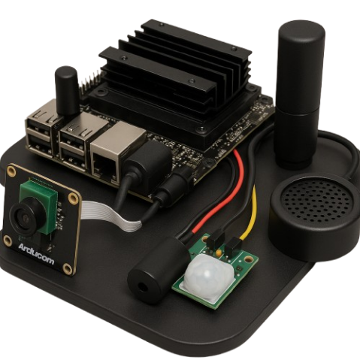
Key Design Principles
Energy Efficiency
  Wake-on-event instead of continuous recording
Privacy & Security
  Local inference, no cloud dependency
Multimodal Intelligence
  Audio + vision for better context
Edge Deployment
  Designed for Jetson Nano–class hardware
Concept Image

Slide 5
Related Work
Conventional CCTV systems
Cloud-based smart cameras (e.g., Ring, Nest)
Edge AI vision systems (YOLO-based detectors)
Limitations of Prior Approaches
Continuous operation
Cloud dependence
High latency
Limited multimodal integration
Our Differentiation
Event-driven activation
Fully offline
Lightweight edge-friendly pipeline (only 4 photos required)

Slide 6
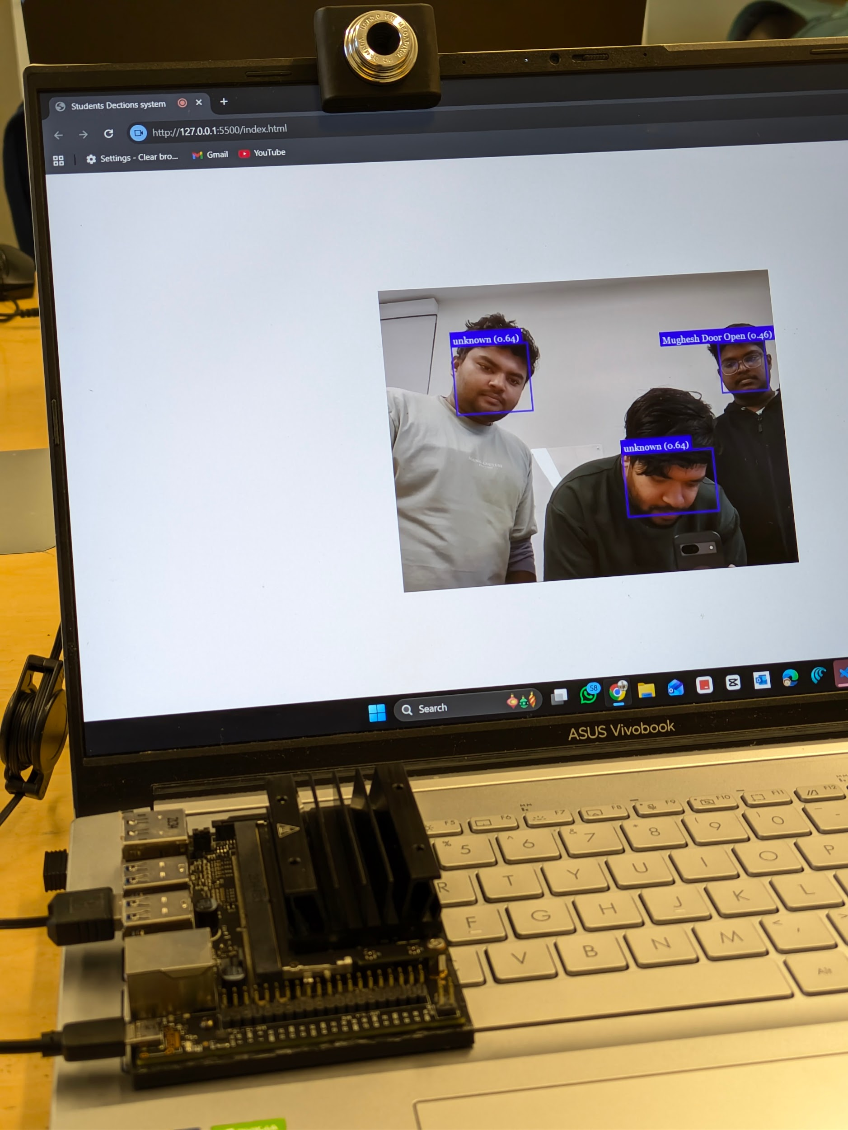
Hardware & Platform
Camera
Target Hardware
NVIDIA Jetson Nano
ARM CPU + CUDA-capable GPU
Designed for edge AI inference
Sensors & I/O
USB Camera (video stream)
Microphone (voice trigger – planned)
Local storage
Software Stack
JavaScript + HTML
face-api.js
WebRTC camera access
On-device ML inference
Video Feed
Jetson Nano

Slide 7

Workflow
NVIDIA JETSON NANO
Microphone
Wake-word/signal
Audio AI
Wake word
Cmd recog
Vision AI
Object detect
Face recog
Camera
(Face Detection)
Motion Sensor
Movement
Recording DATA
Store to microSD/SSD
System is designed to
“listen → see → decide → act”
Buzzer / Speaker

Slide 8
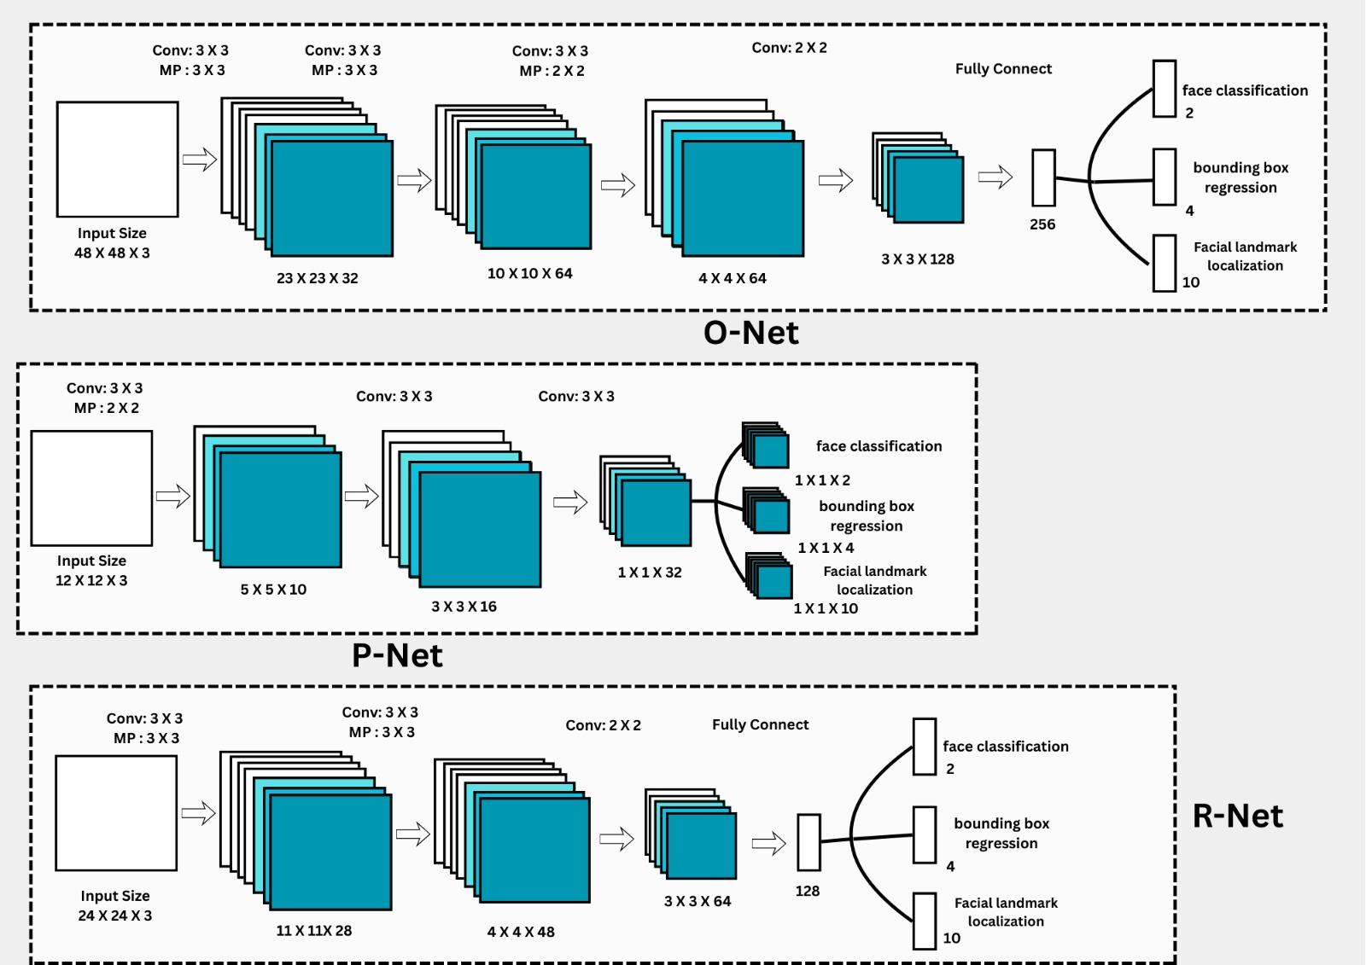
Algorithm - MTCNN
MTCNN is a deep learning model used for face detection and for finding key facial points like the eyes, nose, and mouth.
It is considered a lightweight model because it needs very little training data. MTCNN can work well even with around 4 training images, while regular CNN models usually need more than 1000 images to reach good accuracy.
MTCNN has three main parts: P-Net, R-Net, and O-Net.
P-Net stands for Proposal Network. It gives the first set of possible face regions.
R-Net is the Refine Network. It checks these regions again and improves the bounding boxes.
O-Net is the Output Network. It gives the final results, including the exact face area and the facial landmarks.
All three networks are small convolutional neural networks, which makes the whole model fast. efficie

Slide 9
Dataset & Training Setup
Only 4 Labeled images per user
Multiple images per identity
Stored locally
Face descriptors computed dynamically
Current Labels (Demo)
Mughesh
System supports easy extension by adding only 4 images to label folders

Slide 10
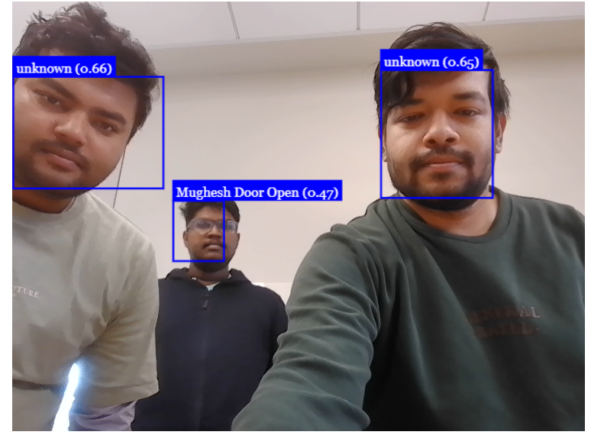
Results
What Works Well
Real-time face detection
Accurate recognition under good lighting
Smooth bounding box rendering
Fully offline operation
Performance
Near real-time inference
Lightweight memory footprint
Edge-friendly compute requirements

Slide 11
Challenges & Limitations
Lighting sensitivity
Limited dataset size results in low accuracy
Audio trigger not yet integrated
Not optimized for Jetson Nano CUDA pipeline

Slide 12
Future Work
Motion-triggered activation
Alert system (LED / buzzer / notification)
Model optimization (TensorRT)
Expanded identity database

Slide 13
Conclusion
Demonstrated a privacy-preserving edge AI security system
Event-driven, multimodal design
Lightweight and extensible architecture
Strong foundation for real-world deployment

Slide 14
Thank You!
GitHub Repository:
https://github.com/Mircea-s-classes/ai-hardware-project-proposal-mst_3

Slide 15
References
M. S. Khan, M. A. Khan, A. Jamalipour, and D. N. K. Jayakody, “Cloud-based smart surveillance systems: A survey,” IEEE Access, vol. 8, pp. 192839–192861, 2020, doi: 10.1109/ACCESS.2020.3033167.
Y. Kang, J. Hauswald, C. Gao, A. Rovinski, T. Mudge, J. Mars, and L. Tang, “Neurosurgeon: Collaborative intelligence between the cloud and mobile edge,” ACM SIGARCH Computer Architecture News, vol. 45, no. 1, pp. 615–629, 2017.
NVIDIA Corporation, Jetson Nano Developer Kit: Bringing AI to the Edge, White Paper, 2019. [Online]. Available: https://developer.nvidia.com/embedded/jetson-nano-developer-kit
F. Schroff, D. Kalenichenko, and J. Philbin, “FaceNet: A unified embedding for face recognition and clustering,” in Proc. IEEE Conf. Computer Vision and Pattern Recognition (CVPR), Boston, MA, USA, 2015, pp. 815–823, doi: 10.1109/CVPR.2015.7298682.
A. G. Howard et al., “MobileNets: Efficient convolutional neural networks for mobile vision applications,” arXiv:1704.04861, 2017.
V. Vinayak, “face-api.js: JavaScript API for face detection and face recognition,” GitHub repository, 2018–present. [Online]. Available: https://github.com/justadudewhohacks/face-api.js
World Wide Web Consortium (W3C), Media Capture and Streams Specification, W3C Recommendation, 2017. [Online]. Available: https://www.w3.org/TR/mediacapture-streams/
T. N. Sainath and C. Parada, “Convolutional neural networks for small-footprint keyword spotting,” in Proc. Interspeech, Dresden, Germany, 2015, pp. 1478–1482.
Y. Zhang, X. Wang, and M. Chen, “Multimodal event-driven artificial intelligence systems for smart environments,” IEEE Internet of Things Journal, vol. 8, no. 6, pp. 4587–4599, Mar. 2021, doi: 10.1109/JIOT.2020.3048721.

